Slide 1
LENDING CLUB EDA ASSIGNMENT SUBMISSION
- R PRAVEEN

Slide 2
Objective
To Analyze and identify patterns from loan application data that would indicate if a borrower of loan is likely to default, which in turn may be used for taking corrective actions which includes denying the loan, reducing the amount of loan, lending at a higher interest rate etc..

Slide 3
Analysis Pipeline
Data Understanding/Exploration
Data Cleaning
Data Analysis
Recommendations

Slide 4
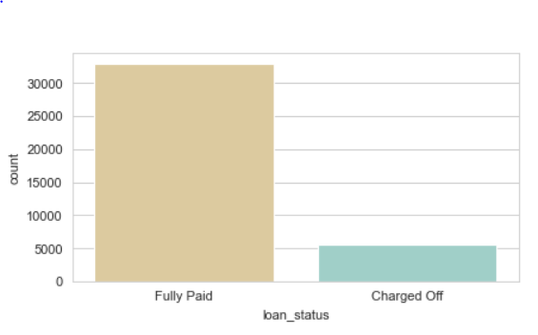
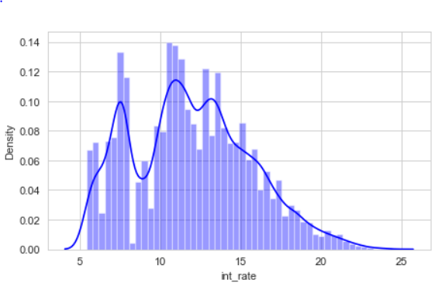
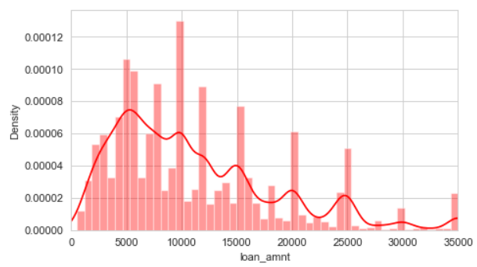
General overview of Data
It turns out that among the total no of loans accepted about 15% of them are charged off the rest are fully paid.
Most loan amounts lent are in the range 2K to 16K.
Among the amounts lent, most of the loans are having interest range between 5% to 10%

Slide 5
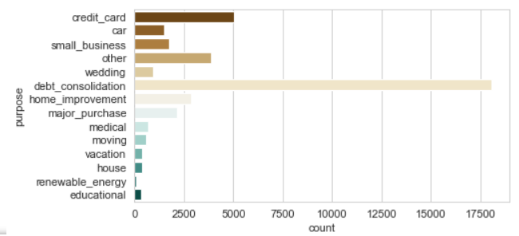
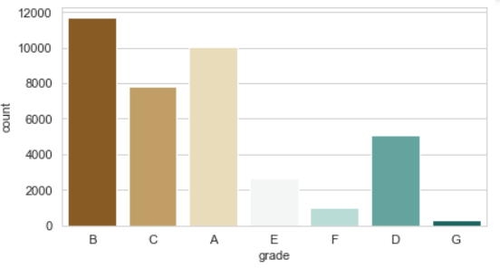
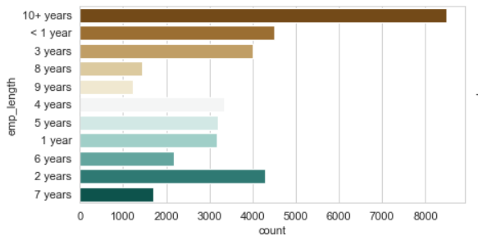
General overview of Data
Maximum number of loans are for debt consolidation, followed by credit card.
Most loans are having high grade A and B.
Majority of the accepted loans are borrowed by borrowers with employment length of either more than 10 yrs or 0-3 years.

Slide 6
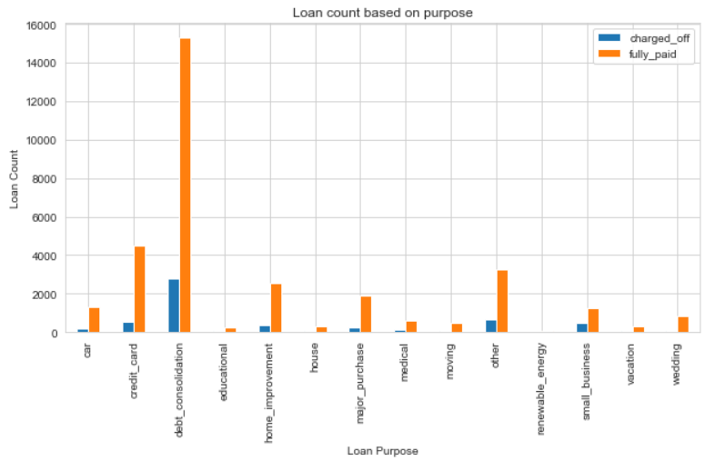
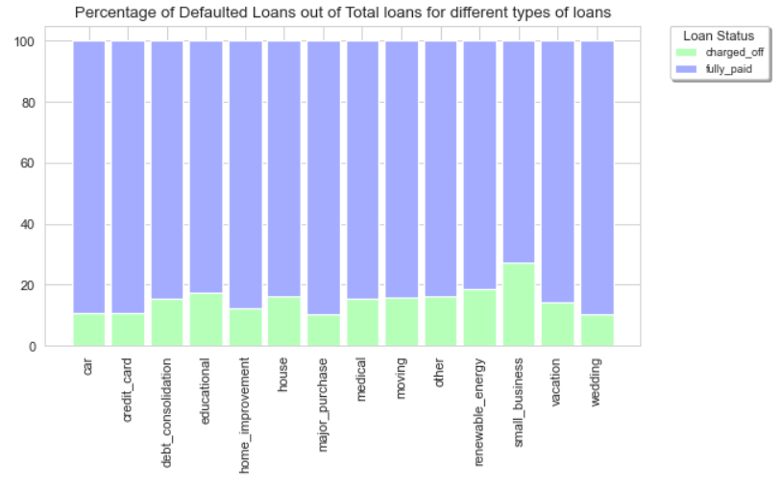
Insights Inferred: Purpose behind loan
It was observed that Small Businesses have had the highest default rate over other purpose.
Also it was interesting to note that debt consolidation had highest no of defaulted loans.

Slide 7
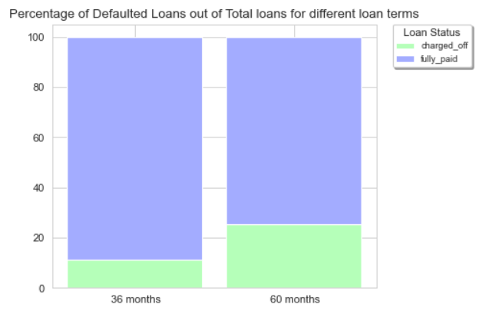
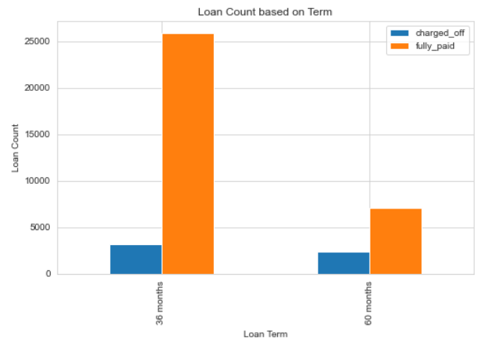
Insights Inferred: Loan Terms
It turns out that most defaulters are observed in loans that spans over 36 months as compared to loans that spans over 60 months
And the Loans whose term is over 60 months have default rate that is twice that of default rate of loans whose term is 36 months.

Slide 8
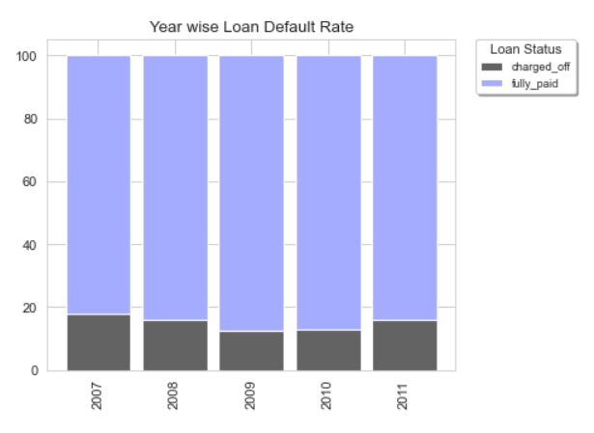
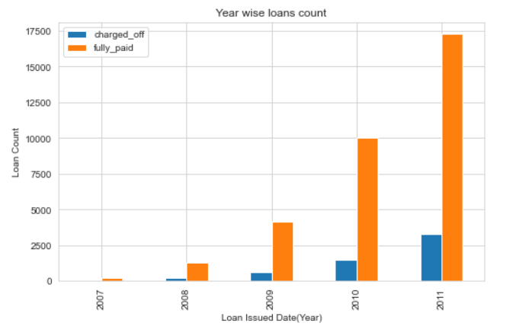
Insights Inferred: Loan Issue Date
Its evident that no of Defaulters are increasing every year.
Its also interesting to note that though defaulters are increasing the default rate was maximum on 2007 followed by 2011

Slide 9
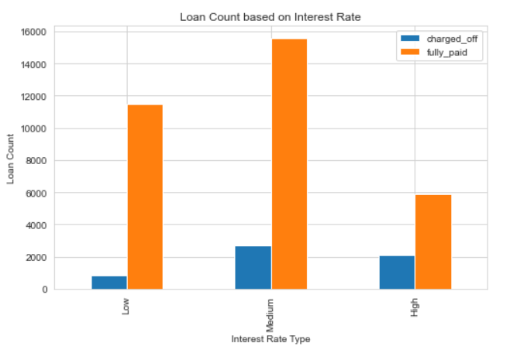
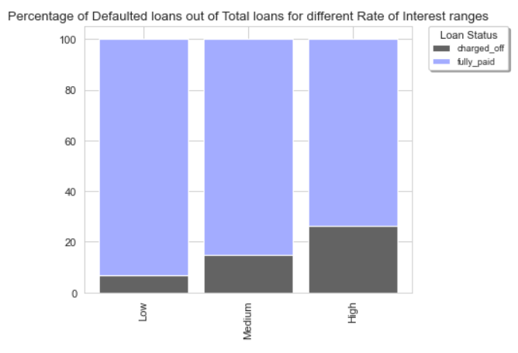
Insights Inferred: Loan Interest Rate
It was observed that the default rate increases as the rate of interest increases.
However it turns out that the defaulters are more likely to be observed in loans where interest rate is between 10% and 15%(Medium) compared to low(<10%) and High(>15%).

Slide 10
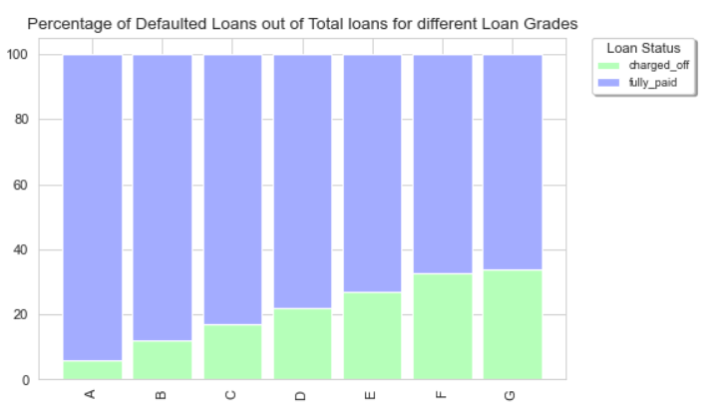
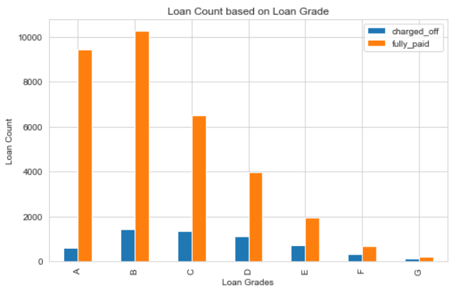
Insights Inferred: Loan Grade
Default rate in loan increases with decrease in Grade quality(A through B) just as in Rate of Interest.
Seems that loan applications with grades B, C and D have the highest no of Defaulters.

Slide 11
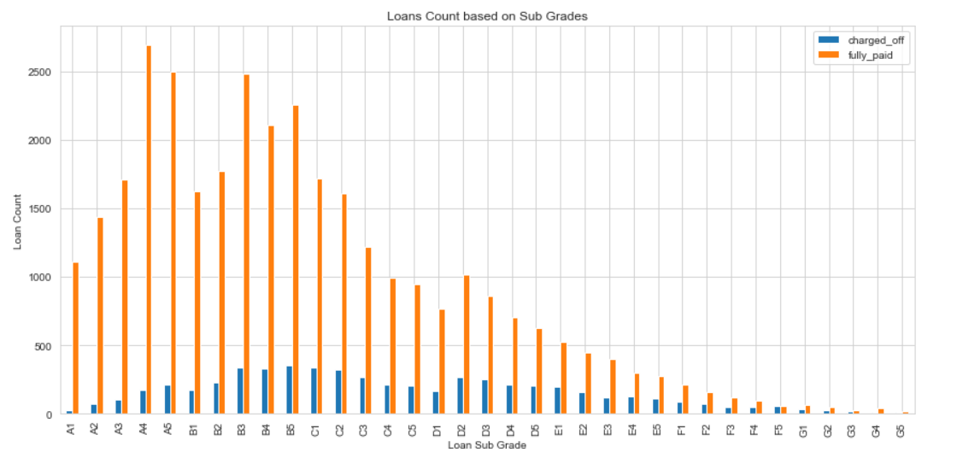
Insights Inferred: Sub Grade
Most Defaulters were found in loans with sub grades B5, B3, C1, B4, C2, D2 and D3.

Slide 12
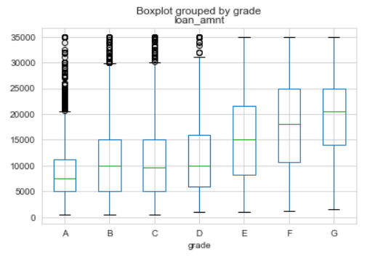
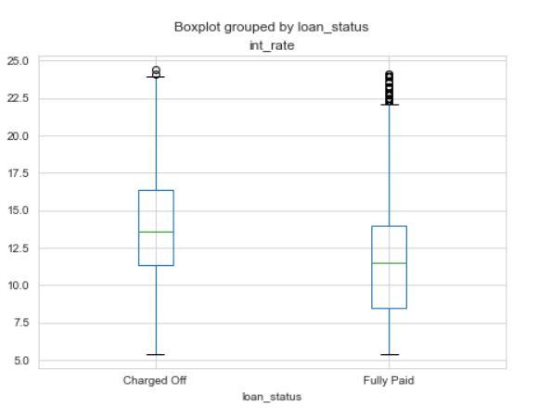
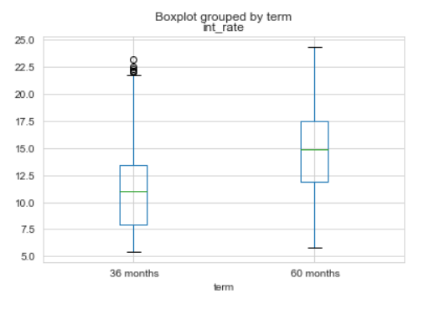
Insights: Grade
It seems that apparently lower grade is given to Large loan amounts.
Loans at a higher interest rate are more likely to be defaulted.
Seems like large amounts are having longer term and hence the interest associated with them is also high.

Slide 13
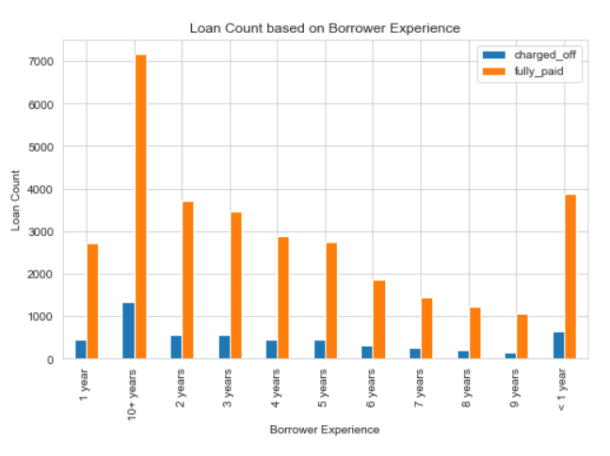
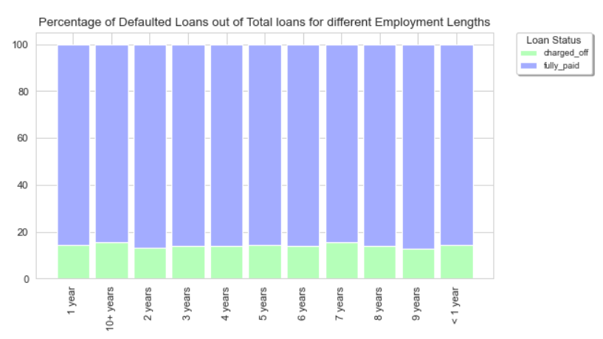
Insights Inferred: Borrower Exp
The defaulters here are most likely to be observed in the case where borrowers experience are 10+ years and 1 year or lesser
As far as default rate is concerned no significant trend is seen as all of them are more or less closer to each other

Slide 14
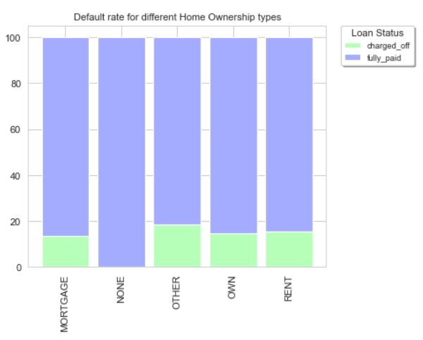
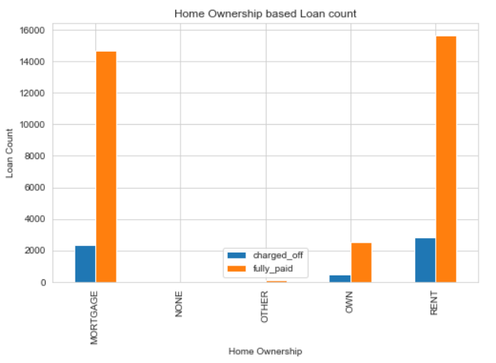
Insights Inferred: Home Ownership
It was observed that Default rate in home ownership type 'Other' is slightly high(more or less same) over others.
However it appears that most defaulters are the borrowers with house ownership type mortgage and rent.

Slide 15
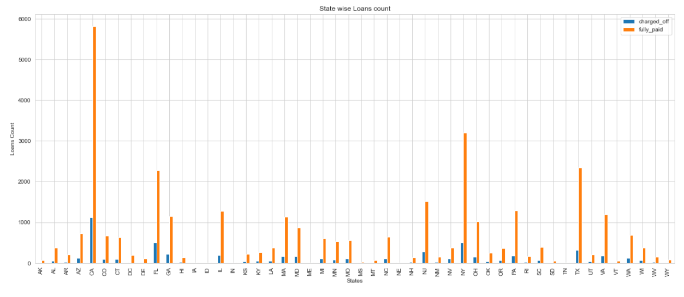
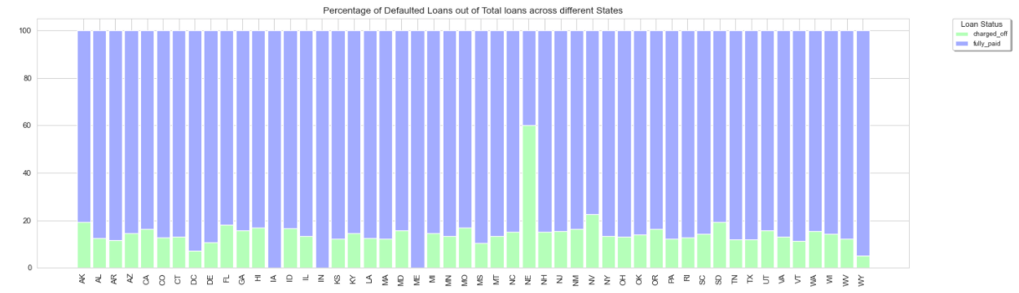
Insights Inferred: Based on State
Default Rate is maximum in the state NE .
It turns out that CA has maximum no of Defaulters followed by NY, FL and TX.

Slide 16
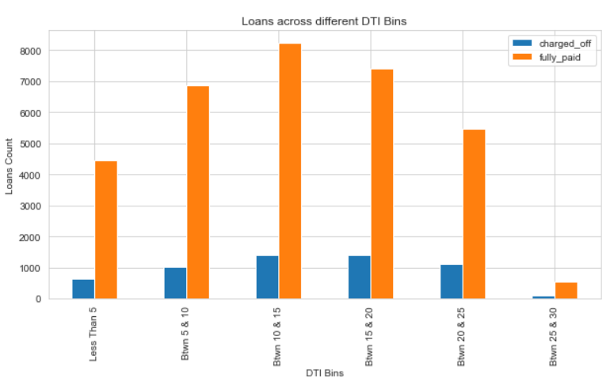
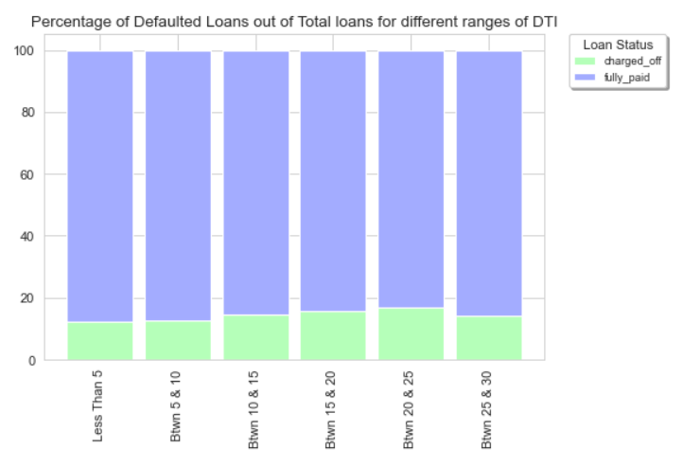
Insights Inferred: DTI
More no of Defaulters were seen in loans with DTI range between 10 & 15 , 15 & 20 , 20& 25 and 5 & 10 respectively.
Default rate was slightly high in loans with DTI between 20 & 25 over others.

Slide 17
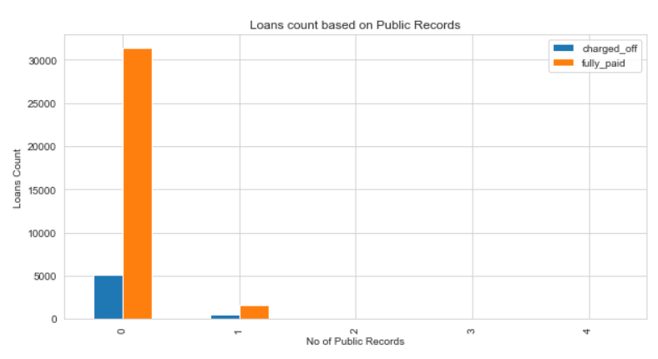
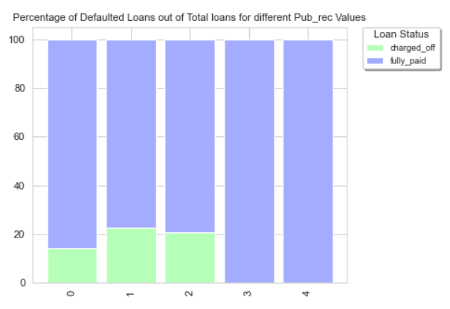
Insights Inferred: Public Records
It turns out that having public derogatory record increases the chances of Charge Off significantly.

Slide 18
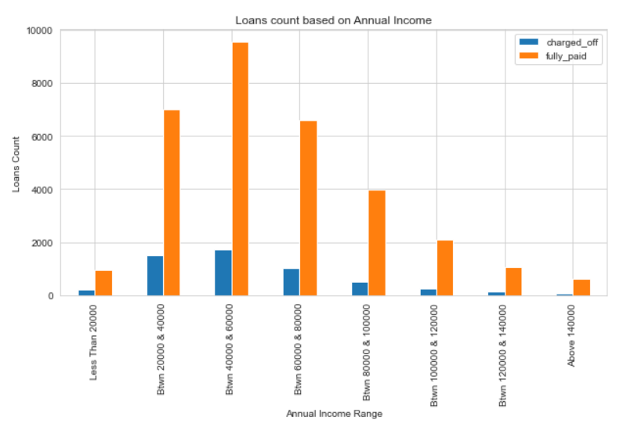
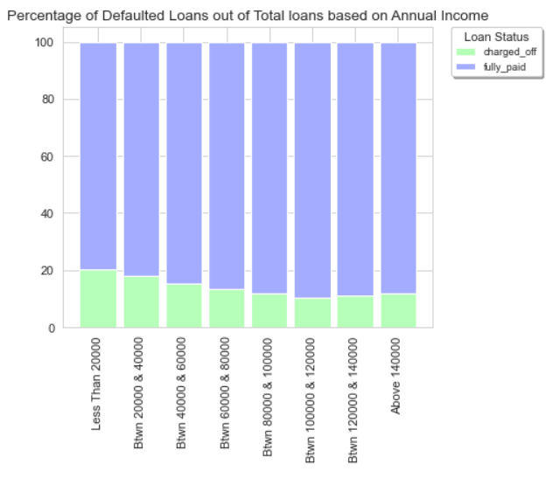
Insights Inferred: Annual Income
It seems that default rate decreases with increase in annual income of the borrower.
Most Defaulters are the Borrowers whose annual income is between 0-20K, 20k-40k and 40K-60K respectively

Slide 19
Features of Interest
Based on our analysis here are some features that will aid in decision making.
Loan Purpose
Loan Grade
Loan Term
Address State
Annual Income
Home Ownership
Public Records

Slide 20
Take Away
Its better to double check or if possible reduce the number of approvals where purpose is small business.
Avoid/Reduce approving loans to people having bad past records.
As Default rate of loans increase from Grades A to G. Loans with higher grades(towards A) should be considered for approval.
Based on analysis it turns out that short term loans are most likely to be fulfilled in time. Therefore focusing more on short term loans will be an appropriate decision.
Borrowers with Rented or Mortgaged house turn out to be defaulters in most cases, therefore its better to avoid such case or should be scrutinised with much more caution.
People with low income tend to fall into Defaulter list. Therefore annual income is a significant feature to be considered during loan approval.

